Slide 1
Part 2.8: Coordination Chemistry

Slide 2
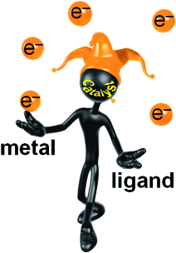
Outline
Coordination Complexes
  History
  Ligands
  Isomers
Inorganic Bonding
Crystal Field Theory
Ligand Field Theory
Orbital Diagrams
Ligand Field
Jahn-Teller Distortion
Bioinorganic Chemistry

Slide 3
History of Inorganic Chemistry
Ancient times through Alchemy:
  Descriptive chemistry, techniques, minerals (Cu compounds), glasses, glazes, gunpowder
17th Century
  Mineral acids (HCl, HNO₃, H₂SO₄), salts and their reactions, acid and bases
  Quantitative work became important, molar mass, gases, volumes
  1869: The periodic table
Late 1800s: Chemical Industry
  Isolate, refine, purify metals and compounds
1896: Discovery of Radioactivity
  Atomic structure, quantum mechanics, nuclear chemistry (through early 20th century)

Slide 4
Inorganic History Side Note
Friedrich Wöhler (1828)
Ammonium Cyanante
Potassium Cyanante
Ammonium Sulfate
Urea
“I can no longer, so to speak, hold my chemical water and must tell you that I can make urea without needing a kidney.”
Wöhler in a letter to Berzelius
Notes:
Vitalism = only animals could make these materials because of their vital force
Urea made in the liver, processed by the kidneys
Taxol = lung, ovarian, breast cancer, head and neck cancer drug (Used in cancer Chemotherapy, inhibits cell division)
Isolated from the Pacific Yew
113 atoms organized in a very specific way

Slide 5
History of Inorganic Chemistry
20th Century
  Coordination chemistry, organometallic chemistry
  WWII & Military projects: Manhattan project, jet fuels (boron compounds)
1950s
  Crystal field theory, ligand field theory, molecular orbital theory
1955
  Organometallic catalysis of organic reaction (polymerization of ethylene)

Slide 6
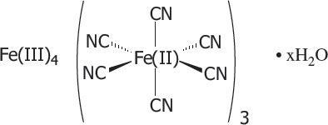
Metal Coordination Complexes
Coordination complexes or coordination compounds- consists of a central atom, which is usually metallic, and a surrounding array of bound molecules or ions, that are in turn known as ligands or complexing agents.
Known for centuries.
Accidentally discovered while trying to make a red dye (1705).
First synthetic blue dye.
Prussian blue
Stable in light and air.
Iron-hexacyanoferrate

Slide 7
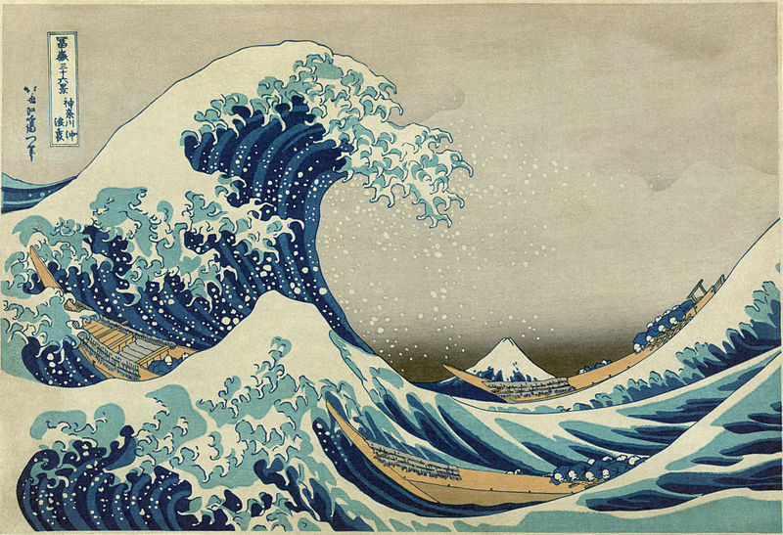
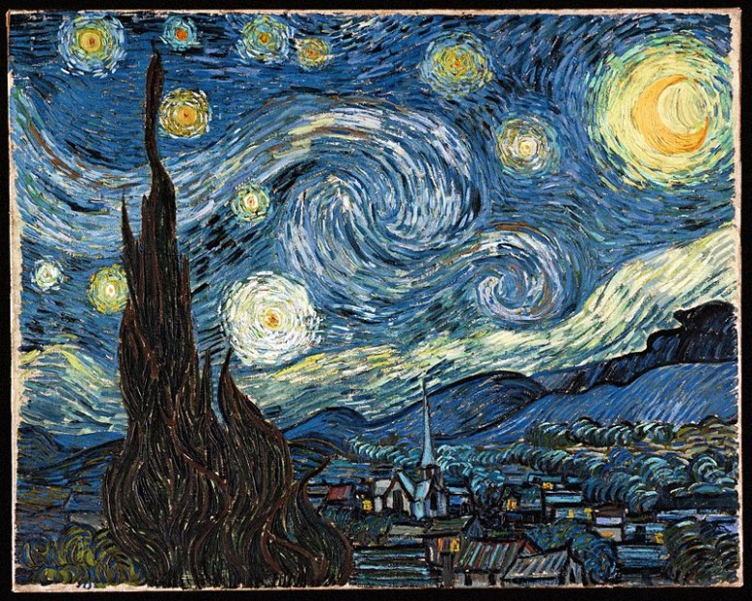
Metal Coordination Complexes
Prussian blue
Iron-hexacyanoferrate
The Great Wave off Kanagawa
Starry Night
Structure of coordination complexes not understood until 1907.

Slide 8
Metal Coordination Complexes
M = transition metal
L = ligand
Ligands are ions or neutral molecules that bond to a central metal atom or ion.
Denticity refers to the number of donor groups in a single ligand that bind to a central atom in a coordination complex. Ligand biting the metal.
Monodentate (one tooth)
Bidentate (two teeth)
Polydentate (many teeth)

Slide 9
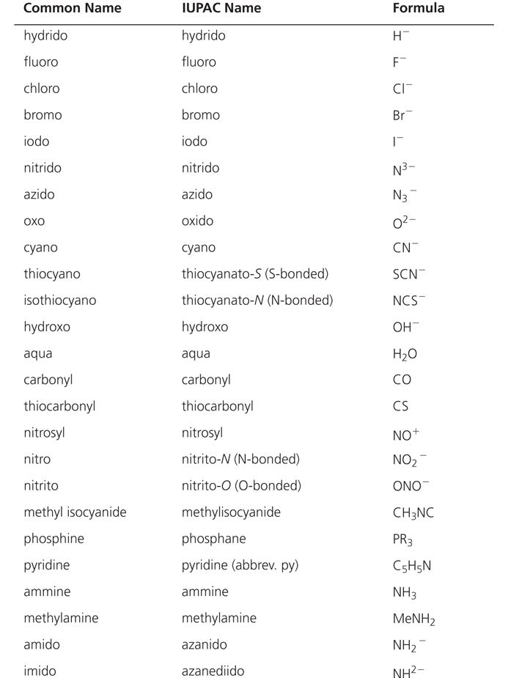
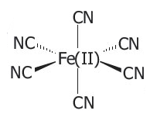

Monodentate Ligands

Slide 10
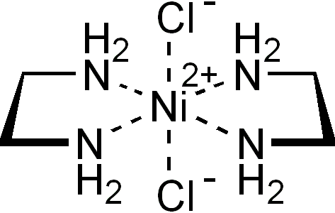
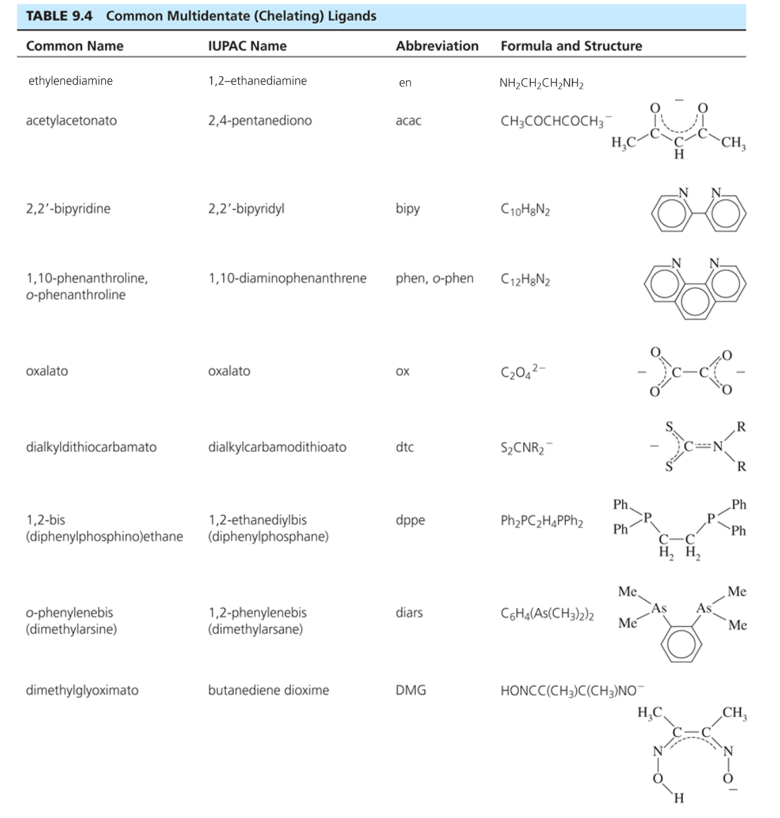
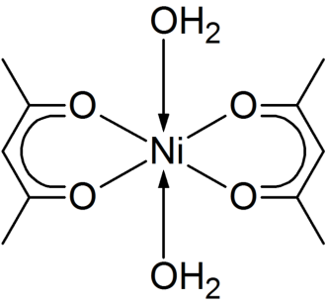
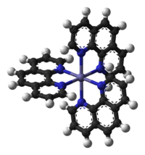
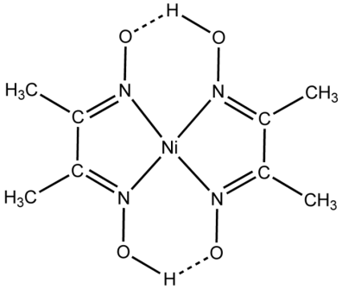
Bidentate Ligands

Slide 11
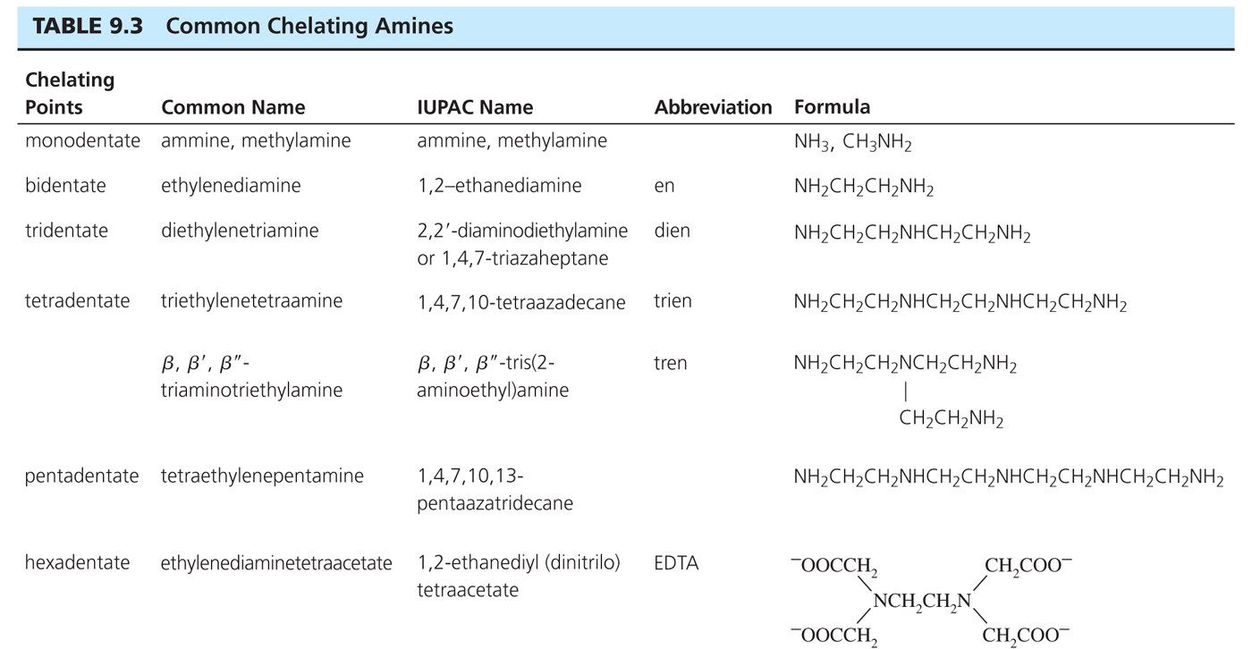
Polydentate Ligands

Slide 12
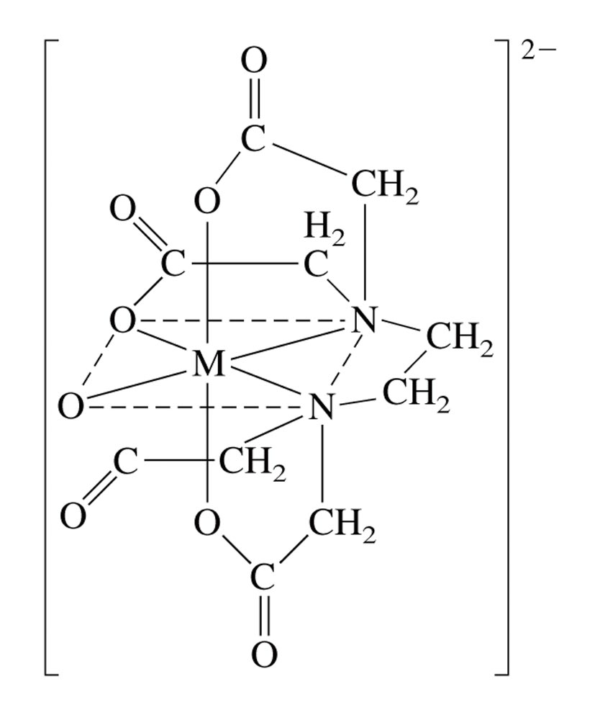
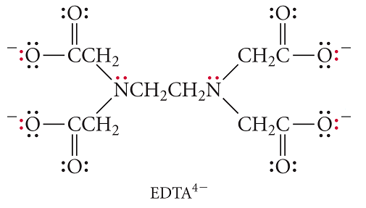
EDTA
ethylenediaminetetraacetate
Added to foods to prevent catalytic oxidation
In cleaning solutions (reduce water hardness)
Chelation therapy for Hg and Pb poisoning
Analytical titrations
Ligands that bind to more than one site are called chelating agents.
M = Mn(II), Cu(II), Fe(III), Pb (II) and Co(III)

Slide 13
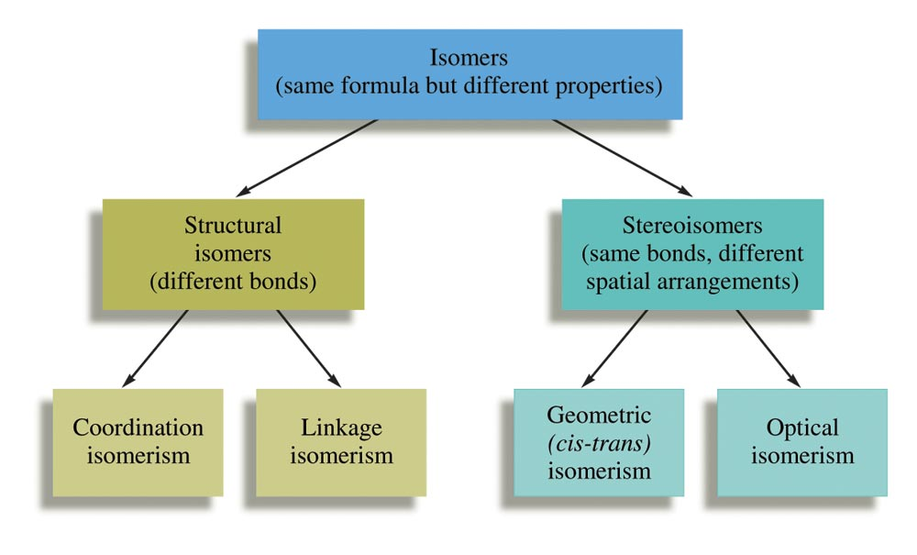
Coordination Complex Isomers
Different connectivities
(same formula).
The same connectivities but different spatial arrangements.

Slide 14
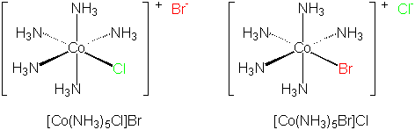
Coordination Isomers
  Same formula different bonding to the metal.
Co + (NH₃)₅ + Cl + Br
Cr + (NH₃)₅ + SO₄ + Br
[Cr(NH₃)₅SO₄]Br and [Cr(NH₃)₅Br]SO₄
Co + Cr + (NH₃)₆ + (CN)₆
[Co(NH₃)₆]³⁺ and [Cr(CN)₆]³⁻) [Cr(NH₃)₆]³⁺and [Co(CN)₆]³⁻

Slide 15
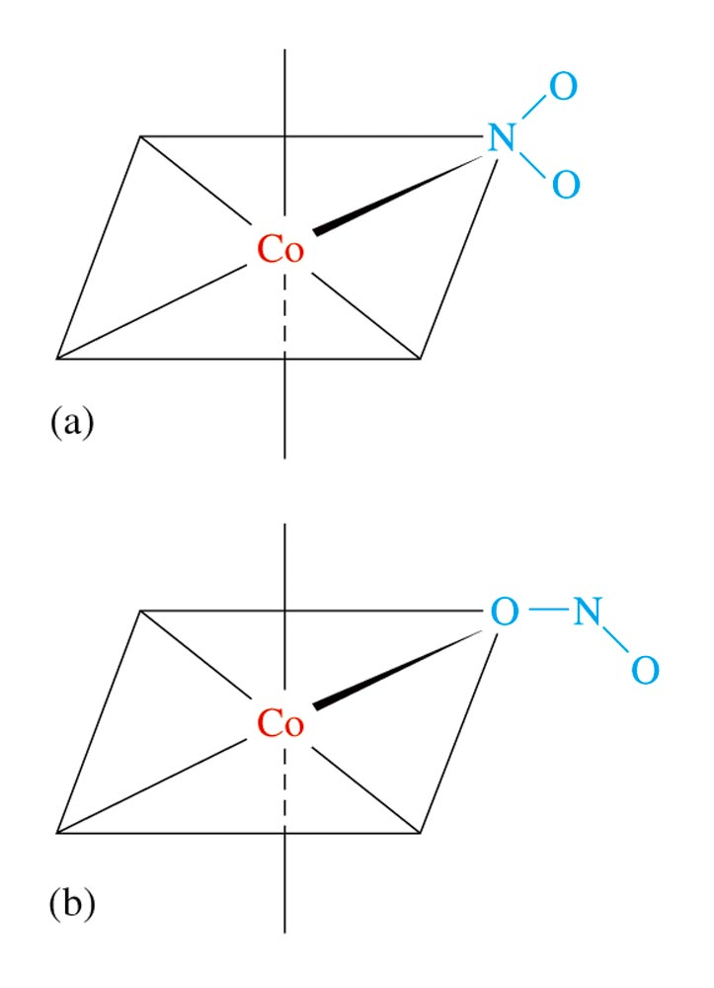
Linkage Isomers
  Composition of the complex is the same, but the point of attachment of the ligands differs.
Formula Name
NO₂⁻ nitrito (via O)
NO₂⁻ nitro (via N)

Slide 16
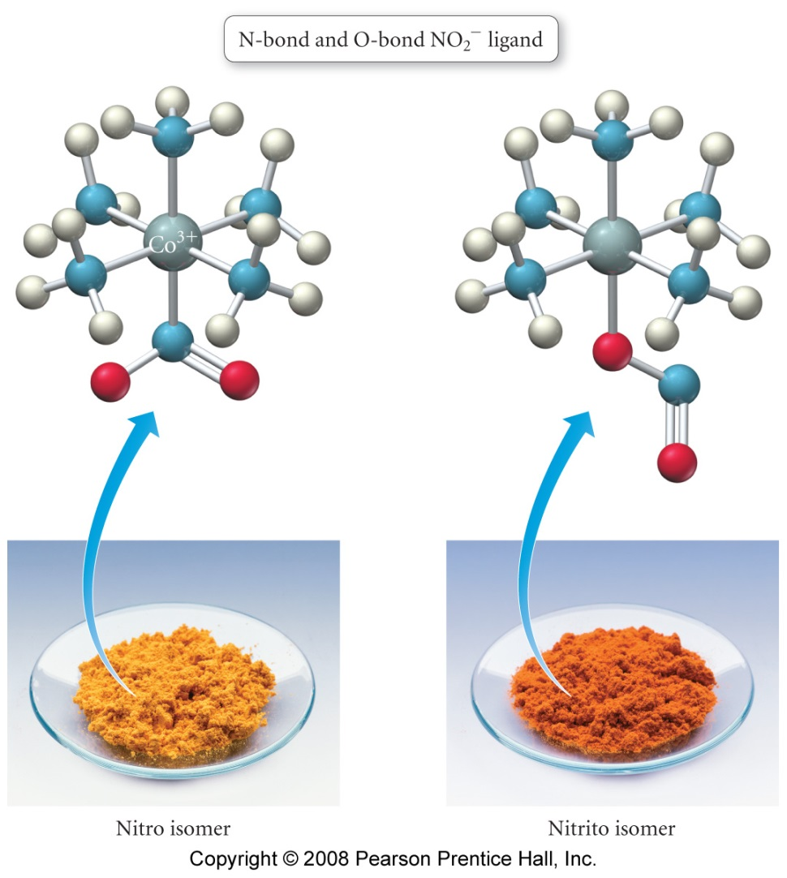

Linkage Isomers
The compounds have different properties and colors.
Linear vs. bent nitrosyl
N or S bond thiocyanate
M-NCS M-SCN

Slide 17
Geometric Isomers
In geometric isomers, the ligands have different spatial arrangements about the metal ion.
Square planar complexes like [MX₂Y₂].
Example: [Pt(NH₃)₂Cl₂].
Octahedral complexes like [MX₄Y₂].
Example: [Pt(NH₃)₄Cl₂].

Slide 18
Geometric Isomers
In geometric isomers, the ligands have different spatial arrangements about the metal ion.
Octahedral complexes with the formula [MX₃Y₃] can be fac (facial) or mer (meridional).

Slide 19
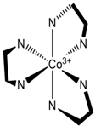
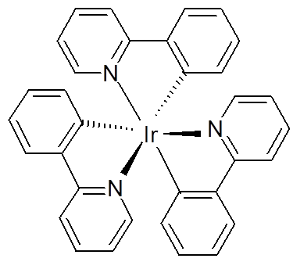
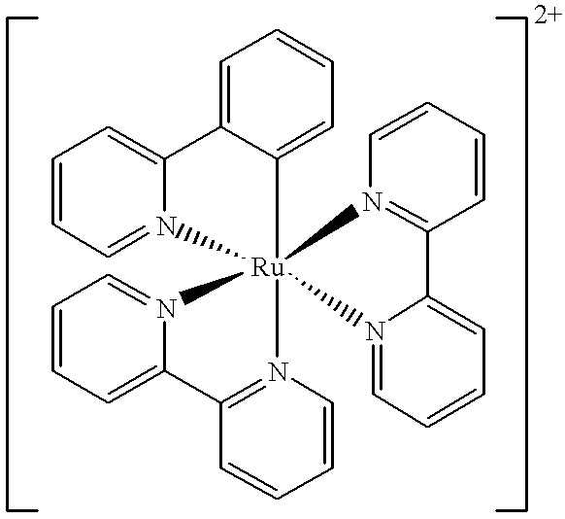
Optical Isomers
Optical isomers are compounds with non-superimposable mirror images (chiral molecules).
Chiral molecules lack an improper axis of rotation (S_{n}), a center of symmetry (i) or a mirror plane (σ)!
C₁, C_{n}, and D_{n} also T, O, and I
Common for octahedral complexes with three bidentate ligands.

Slide 20
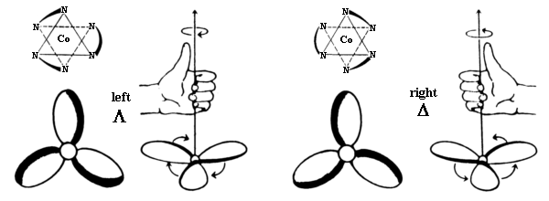
Optical Isomers
Can be viewed like a propeller with three blades.

Slide 21
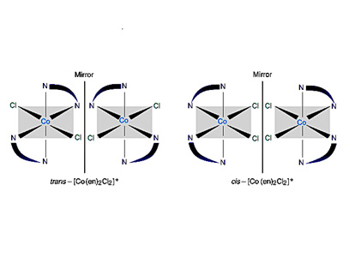
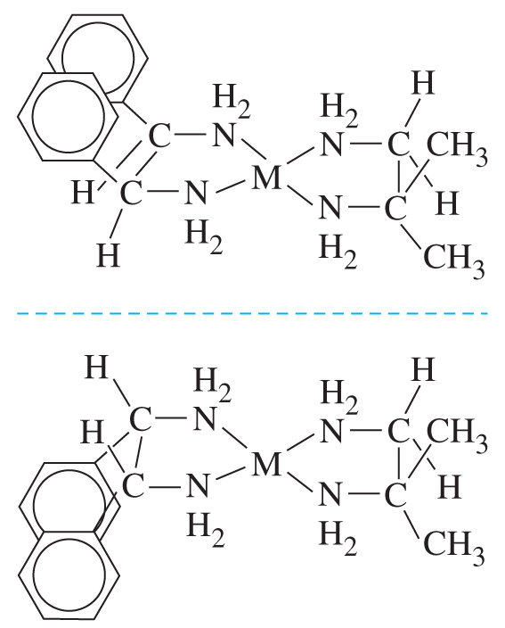
Optical Isomers
Co(en)₂Cl₂
Not Optically active
Optically active

Slide 22
Outline
Coordination Complexes
  History
  Ligands
  Isomers
Inorganic Bonding
Crystal Field Theory
Ligand Field Theory
Orbital Diagrams
Ligand Field
Jahn-Teller Distortion
Bioinorganic Chemistry

Slide 23
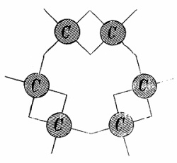
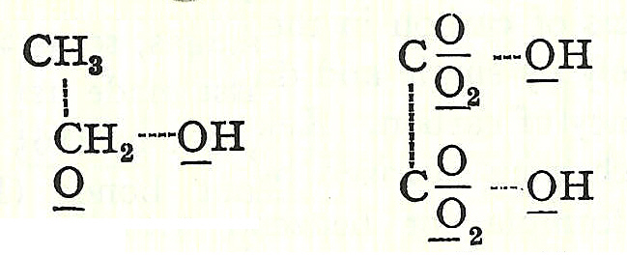
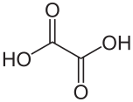

Organic Bonding
1857- Kekule proposes the correct structure of benzene.
1856- Couper proposed that atoms joined to each other like modern-day Tinkertoys.
Ethanol
Oxalic acid

Slide 24

Inorganic Complexes
Co³⁺, 4 x NH₃, 3 x Cl
      Late 1800s- Blomstrand and Jorgenson
Their rules
Charge on the metal ion determined the number of bonds
  - Co³⁺ = 3 bonds
Similar bonding concepts to organics
NH₃ can form chains like -CH₂-
      Only Cl⁻ attached to an NH₃ could dissociate
Did not explain isomers.
Notes:
Precipitation and conductance

Slide 25
Inorganic Complexes
Co³⁺, 6 x NH₃, 3 x Cl
      1893- Werner’s Theory
His rules
Metals interact with 6 ligands in octahedral geometry to form “complex ions”
  Primary/inner coordination sphere: bound to metal
  Secondary/outer coordination sphere: balance charge
Blomstrand Structure
Werner Structure

Slide 26
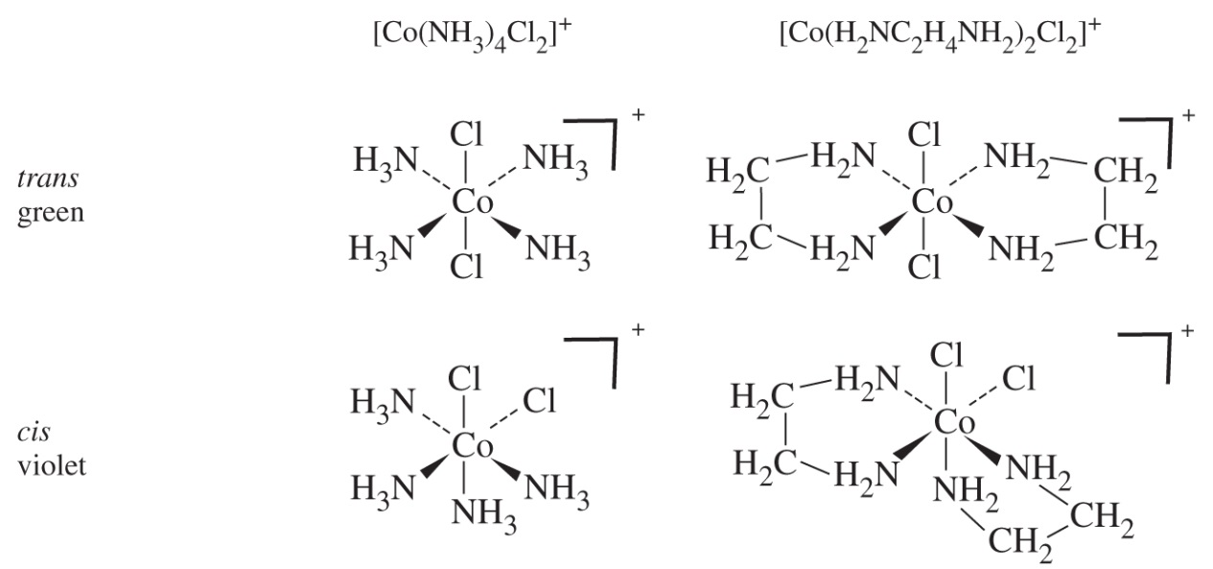
Werner Complexes
    Werner’s Theory
      Explains multiple complexes of the same sets of ligands in different numbers
        [Co(NH₃)₆]Cl₃ [Co(NH₃)₅Cl]Cl₂ [Co(NH₃)₄Cl₂]Cl [Co(NH₃)₃Cl₃]
        Different numbers of ions are produced due to outer sphere dissociation
      Explains multiple complexes with exact same formula = isomers

Slide 27
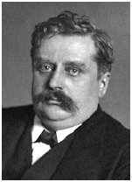
Werner Complexes
    Werner’s Other Contributions
        Coordination Number = Most first row transition elements prefer 6 ligands. Pt²⁺ prefers 4 ligands.
        CoA₄B₂ only has two isomers.
          Not trigonal prismatic because trigonal antiprimatic because they would give 3 isomers.
          Octahedral because it only has two possible isomers.
        PtA₂B₂ only has two isomers so it must be square planar. Tetrahedral would have only 1 isomer.
        Water completes the Inner Sphere coordination in aqueous solutions: NiCl₂ + H₂O [Ni(H₂O)₆]Cl₂

Slide 28
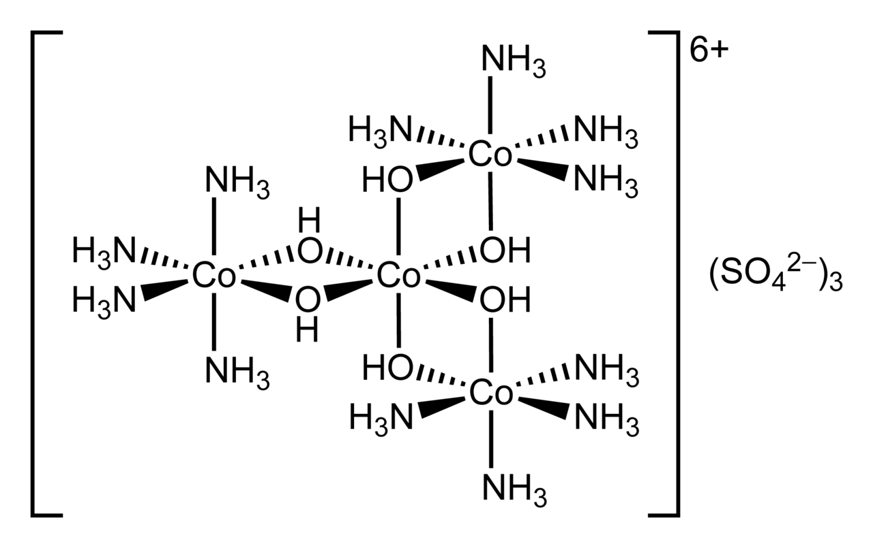
Werner Complexes
    Werner’s Other Contributions
In 1914, Werner resolved hexol, into optical isomers, overthrowing the theory that only carbon compounds could possess chirality.

Slide 29
Werner Complexes
      Werner was awarded the Nobel Prize in 1913 (only inorg. up until 1973)

Slide 30
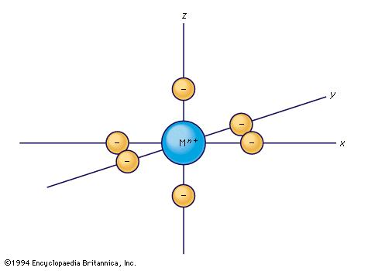
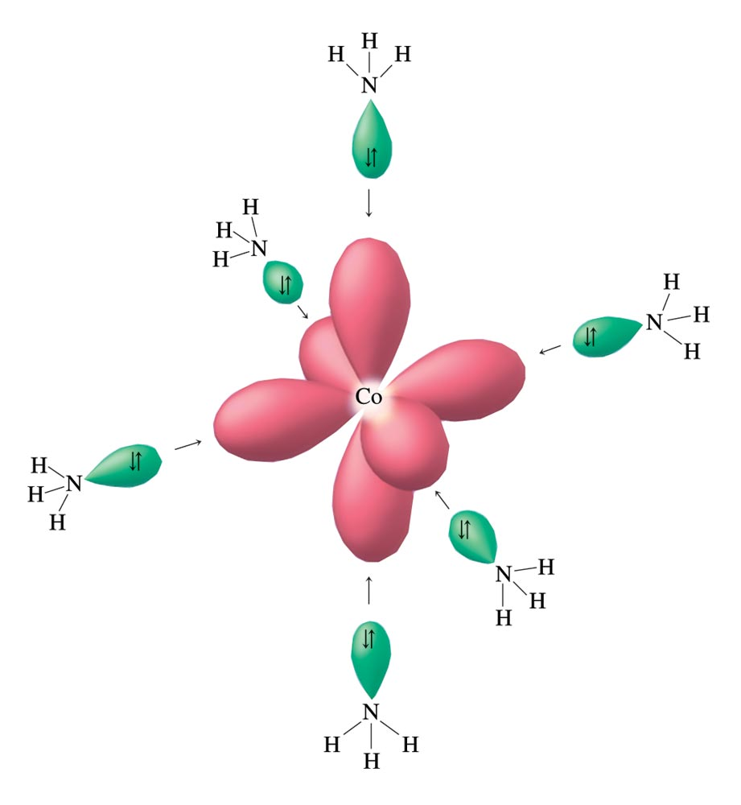
Coordination Complexes
    Shortcomings of Werner’s Theory
      Does not explain the nature of bonding withing the coordination sphere.
      Does not account for the preference between 4- and 6- coordination.
      Does not account for square planar vs tetrahedral.
Crystal Field Theory
Ligand Field Theory

Slide 31
Crystal Field Theory
Electrostatic approach to bonding.
First Applied to ionic crystalline substances.
Assumptions:
Metal ion at the center.
Ligands are treated as point charges.
Bonding occurs through M+ and L- electrostatic attraction.
Bonding is purely ionic.
M and L electrons repel each other.
d orbital degeneracy is broken as ligands approach.

Slide 32
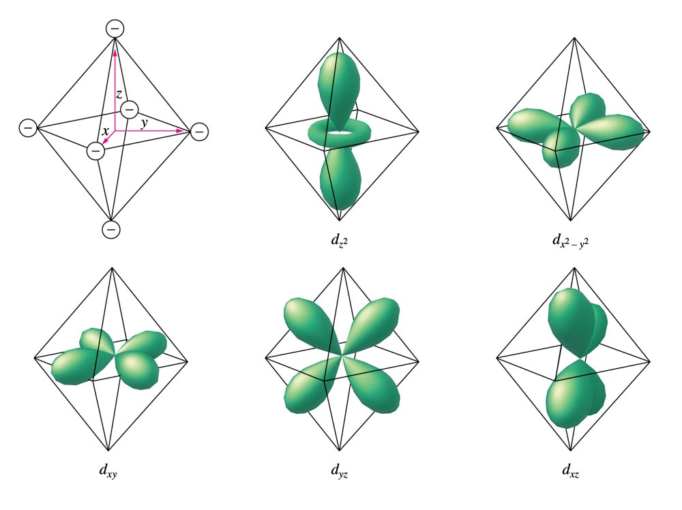
Crystal Field Theory

Slide 33
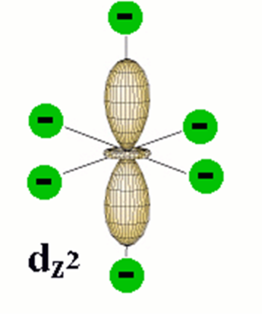
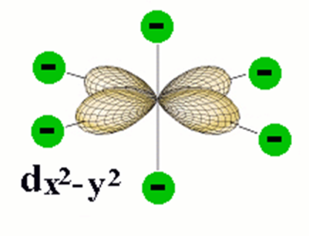
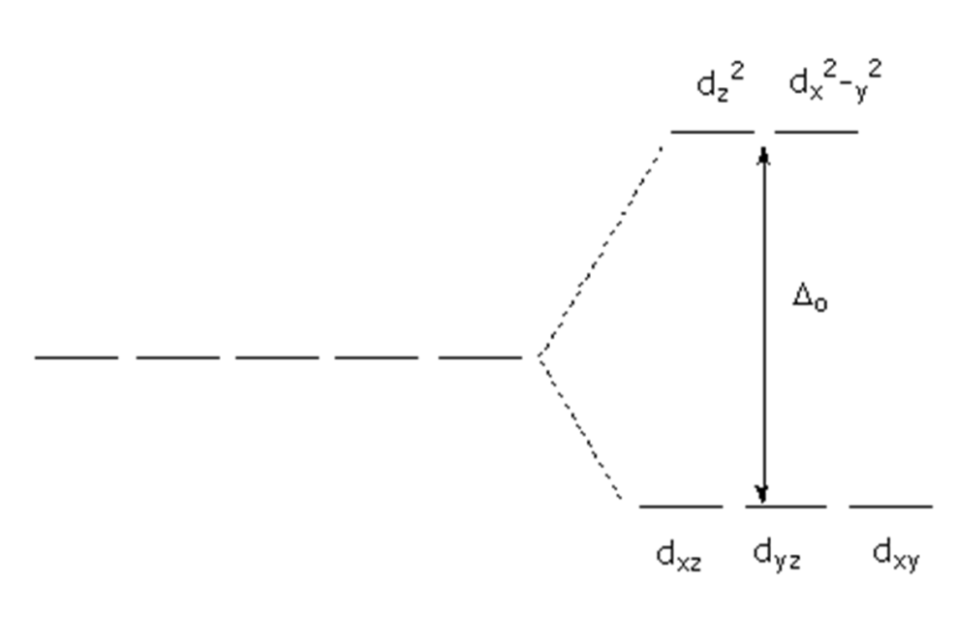
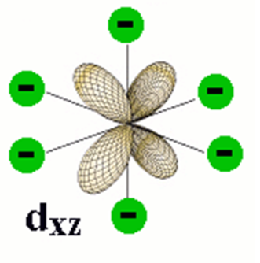
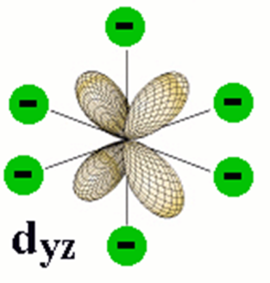
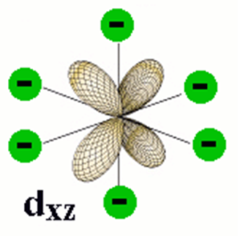
Octahedral Splitting
E
d_{z2} d_{x2-y2} d_{xy} d_{yz} d_{xz}
M
d-orbitals align along the octahedral axis will be affected the most.

Slide 34
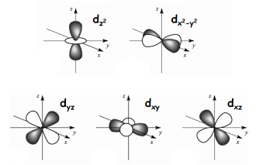
Tetrahedral Splitting
d_{xy}
d_{yz}
d_{xz}
d_{x2-y2}
d_{z2}
Tetrahedral

Slide 35
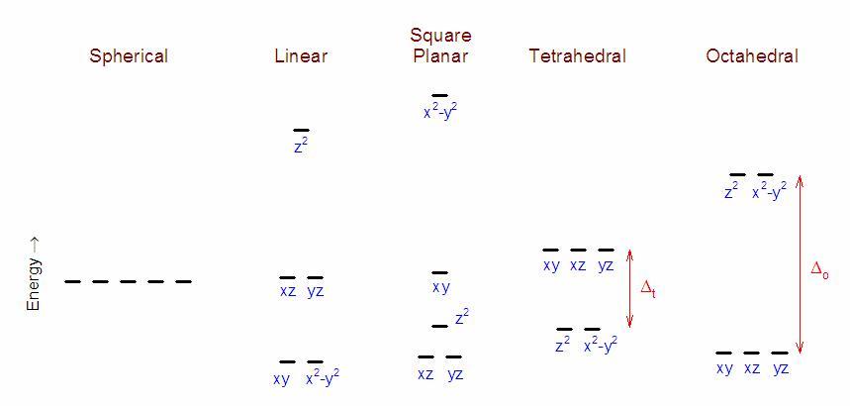
Other Geometries

Slide 36
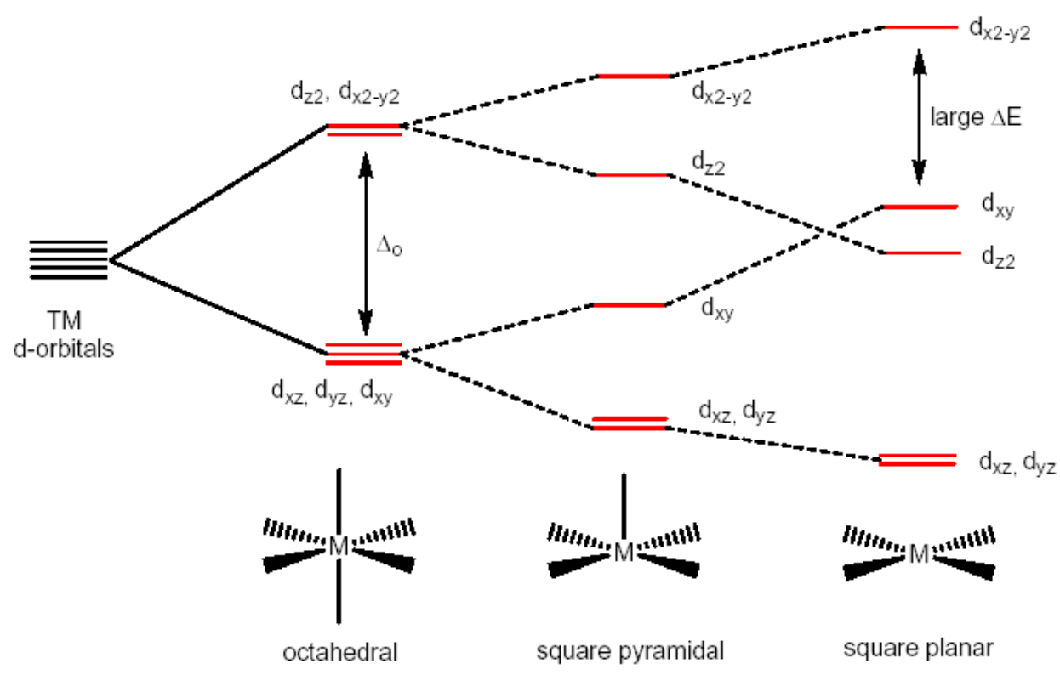
Other Geometries

Slide 37
Crystal Field Theory
Merits of crystal field theory:
Can be used to predict the most favorable geometry for the complex.
Can account for why some complexes are tetrahedral and others square planar.
Usefull in interpreting magnetic properties.
The colors of many transition metal complexes can be rationalized.
Limitations of crystal field theory:
Becomes less accurate as delocalization increases (more covalent character).
Point charge does not accurately represent complexes.
Does not account for pi bonding interactions.
Does not account for the relative strengths of the ligands.

Slide 38
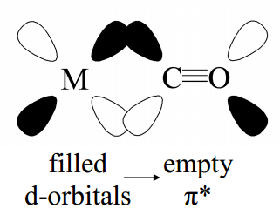
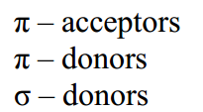
Ligand Field Theory
Application of molecular orbital theory to transition metal complexes.
Ligands are not point charges.
Takes into account π bonding.
Can be used to explain spectrochemical series.
Better than valence-bond model or crystal field theory at explaining experimental data.

Slide 39
Outline
Coordination Complexes
  History
  Ligands
  Isomers
Inorganic Bonding
Crystal Field Theory
Ligand Field Theory
Orbital Diagrams
Ligand Field
Jahn-Teller Distortion
Bioinorganic Chemistry

Slide 40
Outline
Coordination Complexes
  History
  Ligands
  Isomers
Inorganic Bonding
Crystal Field Theory
Ligand Field Theory
Orbital Diagrams
Ligand Field
Jahn-Teller Distortion
Bioinorganic Chemistry
Octahedral
  σ bonding
  π bonding
  Ligand Field Strength
Square Planar
  σ bonding
  π bonding
Tetrahedral
Organometallics

Slide 41

Octahedral σ Only MOs
Assign a point group
Choose basis function
Apply operations
-if the basis stays the same = +1
-if the basis is reversed = -1
-if it is a more complicated change = 0
Generate a reducible representation
O_{h}
H s orbitals
through H-M-H
in-between H
Γ_{Fs}
6
0
0
2
2
0
0
0
4
2

Slide 42
Octahedral σ Only MOs
Assign a point group
Choose basis function
Apply operations
-if the basis stays the same = +1
-if the basis is reversed = -1
-if it is a more complicated change = 0
Generate a reducible representation
Reduce to irreducible representation
Combine orbitals by their symmetry
Fill MOs with e⁻
Generate SALCs of peripheral atoms
Draw peripheral atoms SALC with central atom orbital to generate bonding/antibonding MOs.
O_{h}
H s orbitals

Slide 43
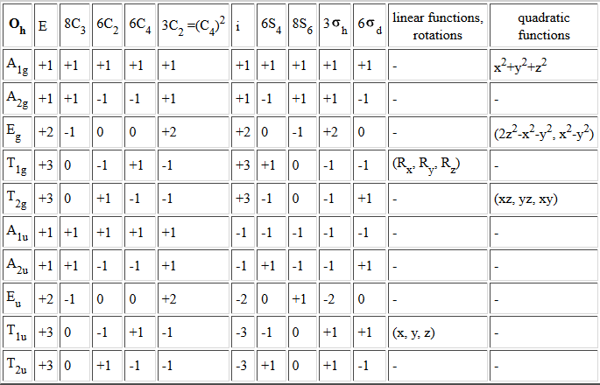
Octahedral σ Only MOs
Reduce to irreducible representation
Γ_{Hs}
2
2
0
0
0
4
2
6
0
0
Γ_{Hs}: A_{1g} + T_{1u} + E_{g}

Slide 44
Octahedral σ Only MOs
Irreducible reps for M orbitals
s
d
p

Slide 45
Octahedral σ Only MOs
Combine the orbital's by their symmetry
T_{1u}
4p
A_{1g}
T_{1u}
4s
E_{g}
A_{1g}
Δ_{o}
3d
T_{2g}
E_{g},T_{2g}
T_{1u}
T_{1u}
E_{g}
A_{1g}
E_{g}
M
A_{1g}
6 x H

Slide 46
Octahedral σ Only MOs
Combine the orbital's by their symmetry
E_{g}
Δ_{o}
3d
E_{g},T_{2g}
T_{2g}
E_{g}
E_{g}
M
L

Slide 47
Octahedral σ Only MOs
Combine the orbital's by their symmetry
E_{g}
E_{g}
Δ_{o}
Δ_{o}
T_{2g}
E_{g},T_{2g}
T_{2g}
E_{g},T_{2g}
E_{g}
L
M
E_{g}
E_{g}
M
L
E_{g}
Weak σ donor
Weak Lewis base
Weaker bonding interaction
Weak Field
Smaller Δ_{o}
Stronger σ donor
Strong Lewis base
Stronger bonding interaction
Strong Field
Larger Δ_{o}

Slide 48
Octahedral σ Only MOs
Combine the orbital's by their symmetry
E_{g}
E_{g}
Δ_{o}
Δ_{o}
T_{2g}
E_{g},T_{2g}
T_{2g}
E_{g},T_{2g}
E_{g}
L
M
E_{g}
E_{g}
M
L
E_{g}
Stronger Lewis base = Larger Δ_{o}
Smaller ligands = Larger Δ_{o}
Δ_{o}: I⁻ < Br⁻ < Cl⁻ < F⁻

Slide 49
Octahedral σ Only MOs
Combine the orbital's by their symmetry
T_{1u}
4p
A_{1g}
T_{1u}
4s
E_{g}
A_{g}
Δ_{o}
3d
T_{2g}
E_{g},T_{2g}
T_{1u}
T_{1u}
E_{g}
A_{1g}
E_{g}
M
A_{1g}
6 x H

Slide 50
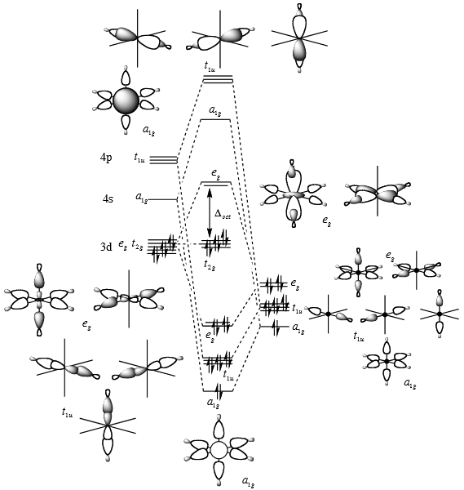
Fill MOs with e⁻
Generate SALCs of peripheral atoms
Draw peripheral atoms SALC with central atom orbital to generate bonding/antibonding MOs.

Slide 51
Octahedral σ Only MOs
s obitals
T_{1u}
4p
T_{1u}
A_{1g}
4s
E_{g}
Γ_{Hs}: A_{1g} + T_{1u} + E_{g}
A_{g}
3d
T_{2g}
p obitals
E_{g},T_{2g}
T_{1u}
T_{1u}
E_{g}
E_{g}
A_{1g}
M
A_{1g}
L
What about p orbitals?
Γ_{p}: A_{1g} + T_{1u} + E_{g}

Slide 52
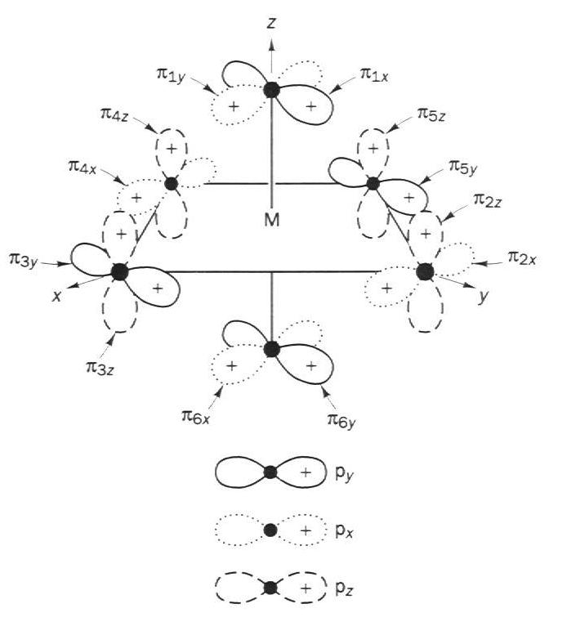
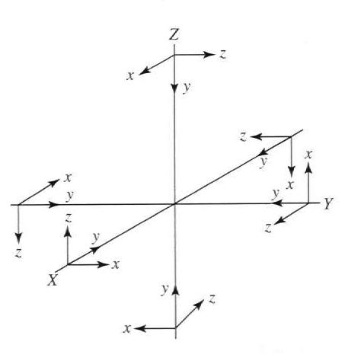
Octahedral σ + π MOs

Slide 53
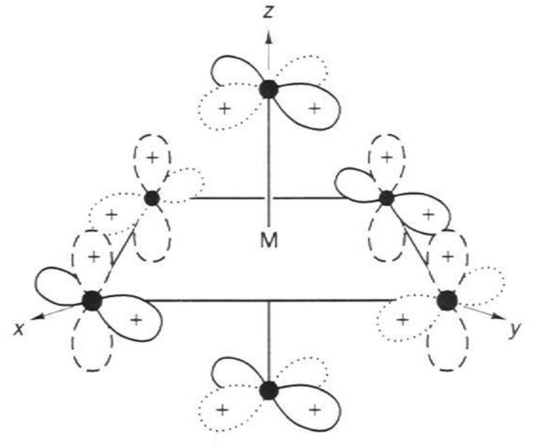
Octahedral σ + π MOs
Assign a point group
Choose basis function (π bonds)
Apply operations
-if the basis stays the same = +1
-if the basis is reversed = -1
-if it is a more complicated change = 0
Generate a reducible representation
Reduce to irreducible representation
O_{h}
π orbitals
through L-M-L
in-between L
Γ_{Lπ}
12
0
0
0
-4
0
0
0
0
0
Γ_{Lπ} = T_{1g} + T_{2g} + T_{1u} + T_{2u}

Slide 54
Octahedral σ + π MOs
Combine the orbital's by their symmetry
Γ_{Lπ} = T_{1g} + T_{2g} + T_{1u} + T_{2u}
T_{1u}
π orbitals
4p
A_{1g}
T_{1u}
T_{2g}
T_{1g}
T_{1u}
T_{2u}
4s
E_{g}
A_{g}
3d
T_{2g}
E_{g},T_{2g}
T_{1u}
σ orbitals
T_{1u}
E_{g}
A_{1g}
E_{g}
M
A_{1g}
L

Slide 55
Octahedral σ + π MOs
Combine the orbital's by their symmetry
T_{1u}
π orbitals
4p
A_{1g}
T_{1u}
T_{2g}
T_{1g}
T_{1u}
T_{2u}
4s
E_{g}
A_{g}
3d
T_{2g}
E_{g},T_{2g}
T_{1u}
σ orbitals
T_{1u}
E_{g}
A_{1g}
E_{g}
M
A_{1g}
L

Slide 56
Octahedral σ + π MOs
Combine the orbital's by their symmetry
filled
donor
base
donates to M
T_{2g}
T_{2g}
E_{g}
E_{g}
E_{g}
Δ_{o}
Δ_{o}
Δ_{o}
T_{2g}
T_{2g}
T_{2g}
T_{2g}
empty
acceptor
acid
accepts from M
M-L_{σ}
T_{2g}

Slide 57
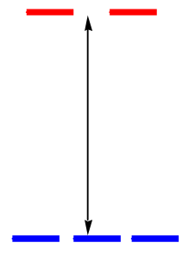

Ligand Field Strength
Strong Field
Weak Field
Stronger σ donor
Strong Lewis base
Stronger bonding interaction
Weak σ donor
Weak Lewis base
Weaker bonding interaction
σ bonding
e_{g}
e_{g}
Δ_{o}
Δ_{o}
t_{2g}
t_{2g}
Empty π acceptor
acid
Accepts from M
Filled π donor
base
Donates to M
π bonding

Slide 58
Ligand Field Strength
e_{g}
e_{g}
Δ_{o}
Δ_{o}
t_{2g}
t_{2g}
Note:
Δ_{ο} increases with increasing formal charge on the metal ion
Δ_{ο} increases on going down the periodic table (larger metal)
Pure σ donating ligands:
Δ_{ο}: en > NH₃
donating ligands:
Δ_{ο} : H₂O > F > RCO₂ > OH > Cl > Br > I
accepting ligands:
Δ_{ο} : CO, CN⁻, > phenanthroline > NO₂⁻ > NCS⁻
The Spectrochemical Series
CO, CN⁻ > phen > NO₂⁻ > en > NH₃ > NCS⁻ > H₂O > F⁻ > RCO₂⁻ > OH₋ > Cl⁻ > Br⁻ > I⁻

Slide 59
Ligand Field Strength
e_{g}
e_{g}
Δ_{o}
Δ_{o}
t_{2g}
t_{2g}
Larger Δ_{ο}
Smaller Δ_{ο}
The Spectrochemical Series
CO, CN⁻ > phen > NO₂⁻ > en > NH₃ > NCS⁻ > H₂O > F⁻ > RCO₂⁻ > OH₋ > Cl⁻ > Br⁻ > I⁻
Why do we care?
Predict/Tune/Understand the:
Photophysical properties of metal coordination complexes.
Magnetic properties of metal coordination complexes.
And others.

Slide 60

Photophysical Properties
Larger Δ_{ο}
Smaller Δ_{ο}
The Spectrochemical Series
CO, CN⁻ > phen > NO₂⁻ > en > NH₃ > NCS⁻ > H₂O > F⁻ > RCO₂⁻ > OH₋ > Cl⁻ > Br⁻ > I⁻
Increasing Δ

Slide 61
Magnetic Properties
Strong field
Weak field
Strong field
Weak field
d¹
d²
d³
d⁴

Slide 62
Pairing Energy, Π
Hund's Rules
The pairing energy, Π, is made up of two parts.
Coulombic repulsion energy caused by having two electrons in same orbital. Destabilizing energy contribution of Π_{c} for each doubly occupied orbital.
Less repulsion
Less p⁺ screening
Medium Energy
High Energy
Exchange stabilizing energy for each pair of electrons having the same spin and same energy. Stabilizing contribution of Π_{e} for each pair having same spin and same energy.
Low Energy
Medium Energy

Slide 63
Side note: Exchange Energy, Π_{e}
S₂
S₁
ΔE_{ST} ≈ Π_{e}≈ 2J_{e}
E
T₁
Singlet Excited State (S₁)
S₀
Excitation
Internal Conversion
Fluorescence
Non-radiative decay
Intersystem Crossing
Phosphorescence
Triplet Excited State (T₁)
Ground
State (S₀)
Notes:
Je is the exchange integral

Slide 64
Pairing Energy, Π
Hund's Rules
The pairing energy, Π, is made up of two parts.
Coulombic repulsion energy caused by having two electrons in same orbital. Destabilizing energy contribution of Π_{c} for each doubly occupied orbital.
Less repulsion
Less p⁺ screening
Medium Energy
High Energy
Exchange stabilizing energy for each pair of electrons having the same spin and same energy. Stabilizing contribution of Π_{e} for each pair having same spin and same energy.
Low Energy
Medium Energy
Π = sum of all Π_{c} and Π_{e} interactions
Low Energy
High Energy

Slide 65
Π vs. Δ_{o}
d⁴
Strong field =
Low spin
(2 unpaired)
Δ_{o}
Weak field =
High spin
(4 unpaired)
Δ_{o}
Π < Δ_{o}
Π > Δ_{o}
When the 4th electron will either go into the higher energy e_{g} orbital at an energy cost of Δ₀ or be paired at an energy cost of Π, the pairing energy.

Slide 66
Magnetic Properties
d⁵
d⁶
d⁷
1 u.e.
5 u.e.
0 u.e.
4 u.e.
1 u.e.
3 u.e.
d⁸
d⁹
d¹⁰
2 u.e.
2 u.e.
1 u.e.
1 u.e.
0 u.e.
0 u.e.

Slide 67
Magnetic Properties
Larger Δ_{ο}
Smaller Δ_{ο}
The Spectrochemical Series
CO, CN⁻ > phen > NO₂⁻ > en > NH₃ > NCS⁻ > H₂O > F⁻ > RCO₂⁻ > OH₋ > Cl⁻ > Br⁻ > I⁻
High Spin
Low Spin
Paramagnetic-
unpaired electrons.
Diamagnetic-
all electrons paired.

Slide 68
Ligand Field Strength
e_{g}
e_{g}
Δ_{o}
Δ_{o}
t_{2g}
t_{2g}
Pure σ donating ligands:
Δ_{ο}: en > NH₃
donating ligands:
Δ_{ο} : H₂O > F > RCO₂ > OH > Cl > Br > I
accepting ligands:
Δ_{ο} : CO, CN⁻, > phenanthroline > NO₂⁻ > NCS⁻
Larger Δ_{ο}
Smaller Δ_{ο}
The Spectrochemical Series
CO, CN⁻ > phen > NO₂⁻ > en > NH₃ > NCS⁻ > H₂O > F⁻ > RCO₂⁻ > OH₋ > Cl⁻ > Br⁻ > I⁻

Slide 69

Outline
Coordination Complexes
  History
  Ligands
  Isomers
Inorganic Bonding
Crystal Field Theory
Ligand Field Theory
Orbital Diagrams
Ligand Field
Jahn-Teller Distortion
Bioinorganic Chemistry
Octahedral
  σ bonding
  π bonding
  Ligand Field Strength
Square Planar
  σ bonding
  π bonding
Tetrahedral
Organometallics

Slide 70





Square Planar

Slide 71


Square Planar MOs
Assign a point group
Choose basis function (p orbitals of L)
Use a local coordinate system on each ligand with:
y pointing in towards the metal. (p_{y} = σ bonding)
z being perpendicular to the molecular plane. (p_{z} = π⊥ bonding)
x lying in the molecular plane. (p_{x} = π|| bonding)
D_{4h}
p orbitals of L
π orbitals (p_{x,z})
σ orbitals (p_{y})

Slide 72

Square Planar MOs
Assign a point group
Choose basis function (p orbitals of L)
Apply operations
-if the basis stays the same = +1
-if the basis is reversed = -1
-if it is a more complicated change = 0
D_{4h}
p orbitals of L
σ orbitals (p_{y})
Γ_{σ(py)}: A_{1g} + B_{1g} + E_{u}

Slide 73

Square Planar MOs
Assign a point group
Choose basis function (orbitals)
Apply operations
Generate a reducible representation
Reduce to irreducible representation
Combine orbitals by their symmetry
D_{4h}
p orbitals of L
σ orbitals (p_{y})
Γ_{σ(py)}: A_{1g} + B_{1g} + E_{u}

Slide 74

Square Planar MOs
Irreducible reps for M orbitals
s
d
p

Slide 75

Square Planar MOs

Slide 76

π Bonding in Square Planar MOs
π orbitals (p_{x,z})
D_{4h}
π orbitals of L

Slide 77

π Bonding in Square Planar MOs

Slide 78

Complete Square Planar MOs

Slide 79
Outline
Coordination Complexes
  History
  Ligands
  Isomers
Inorganic Bonding
Crystal Field Theory
Ligand Field Theory
Orbital Diagrams
Ligand Field
Jahn-Teller Distortion
Bioinorganic Chemistry
Octahedral
  σ bonding
  π bonding
  Ligand Field Strength
Square Planar
  σ bonding
  π bonding
Tetrahedral
Organometallics

Slide 80




σ Only T_{d} MOs
Γ_{σ}
4
2
1
0
0
Γ_{σ}: A₁ + T₂

Slide 81


σ Only T_{d} SALC
φ₂
φ₃
φ₁
φ₄
Γ_{σ}: A₁ + T₂

Slide 82

σ Only T_{d} MOs

Slide 83
Outline
Coordination Complexes
  History
  Ligands
  Isomers
Inorganic Bonding
Crystal Field Theory
Ligand Field Theory
Orbital Diagrams
Ligand Field
Jahn-Teller Distortion
Bioinorganic Chemistry
Octahedral
  σ bonding
  π bonding
  Ligand Field Strength
Square Planar
  σ bonding
  π bonding
Tetrahedral
Organometallics

Slide 84

Organometallic Chemistry
Organometallic compound- a complex with direct metal-carbon bonds.
Zeise’s salt- the first organometallic compound
Isolated in 1825 (by William Zeise)
Structure confirmed in 1838.

Slide 85

π-bonding Ligands

Slide 86





History of Ferrocene
Pauson and Kealy (1951 )
FeCl₃
+
Fulvalene
orange solid of "remarkable stability"
Nature 1951, 168, 1039 - 1040
Wilkinson and Fischer (1952)
G. Wilkinson, M. Rosenblum, M. C. Whiting, R. B. Woodward Journal of the American Chemical Society 1952, 74, 2125–2126.
E. O. Fischer, W. Pfab Zeitschrift für Naturforschung B 1952, 7, 377–379.

Slide 87







Ferrocene
The first sandwich complex.
Fuel additives-anitknocking agents.
Electrochemical standard.
Some derivatives show anti-cancer activity.
Small rotation barrier (~ 4 kJmol^{‐1}) and ground state structures of ferrocene can be D_{5d} or D_{5h}.
  D_{5d}
D₅
  D_{5h}
What about the bonding?

Slide 88





π MOs of Cyclopentadienyl
C₅H₅⁻
Decomposition/Reduction Formula
D_{5h}

Slide 89


π MOs of Cyclopentadienyl
Generate SALC
Energy increases as the # of nodes increases.

Slide 90



π MOs of Ferrocene
C₅H₅⁻
Fe(C₅H₅)₂
D_{5h}
D_{5d}

Slide 91

π MOs of Ferrocene
Fe(C₅H₅)₂
Decomposition/Reduction Formula
D_{5d}

Slide 92

π MOs of Ferrocene
From the equation
Generate SALC
Assemble 2 x C₅H₅⁻

Slide 93





π MOs of Ferrocene
2 x

Slide 94


π MOs of Ferrocene

Slide 95
π MOs of Ferrocene
D_{5h}
D_{5d}
E₂”
E₂”
E_{2g}
E_{2u}
E_{2g}
E_{2u}
E₁ ”
E₁ ”
E_{1g}
E_{1u}
E_{1g}
E_{1u}
A₂”
A_{2u}
A_{1g}

Slide 96

π MOs of Ferrocene

Slide 97

π MOs of Ferrocene

Slide 98

π MOs of Ferrocene

Slide 99

π MOs of Ferrocene

Slide 100
π MOs of Ferrocene

Slide 101
Outline
Coordination Complexes
  History
  Ligands
  Isomers
Inorganic Bonding
Crystal Field Theory
Ligand Field theory
Orbital Diagrams
Ligand Field
Jahn-Teller Distortion
Bioinorganic Chemistry

Slide 102
Jahn-Teller Distortion
Jahn-Teller theorem:
“there cannot be unequal occupation of orbitals with identical energy”
Molecules will distort to eliminate the degeneracy!
E
Distortion
d⁹
d³
1 u.e.
1 u.e.
equal occupation
unequal occupation

Slide 103

Jahn-Teller Distortion
2.45 Å
2.00 Å
d_{x}2_{-y}2
e_{g}
d_{z}2
E
d_{xy}
t_{2g}
d_{xz}
d_{yz}
[Cu(H₂O)₆]²⁺

Slide 104


Jahn-Teller Distortion

Slide 105



Jahn-Teller Distortion

Slide 106
Outline
Coordination Complexes
  History
  Ligands
  Isomers
Inorganic Bonding
Crystal Field Theory
Ligand Field theory
Orbital Diagrams
Ligand Field
Jahn-Teller Distortion
Bioinorganic Chemistry

Slide 107

Transition Metals in Biochemistry

Slide 108
Metals in Biochemistry
Transport/storage proteins :
Transferrin (Fe)
Ferritin (Fe) Metallothionein (Zn)
O₂ binding/transport: Myoglobin (Fe)
Hemoglobin (Fe)
Hemerythrin (Fe)
Hemocyanin (Cu)
Enzymes (catalysts)
Hydrolases: Carbonic anhydrase (Zn)
Carboxypeptidase (Zn)
Oxido-Reductases: Alcohol dehydrogenase (Zn)
Superoxide dismutase (Cu, Zn, Mn, Ni)
Catalase, Peroxidase (Fe)
Nitrogenase (Fe, Mo)
Cytochrome oxidase (Fe, Cu)
Hydrogenase (Fe, Ni)
Isomerases: B₁₂ coenzymes (Co)
Aconitase (Fe-S)
Oxygenases: Cytochrome P450 (Fe)
Nitric Oxide Synthases (Fe)
Electron carriers: Cytochromes (Fe)
Iron-sulfur (Fe)
Blue copper proteins (Cu)
Structural
Skeletal roles via biomineralization
Ca²⁺, Mg²⁺, P, O, C, Si, S, F as anions, e.g. PO₄³⁻, CO₃²⁻.
Charge neutralization.
Mg²⁺, Ca²⁺ to offset charge on DNA ⁻ phosphate anions
Charge carriers: Na+, K⁺, Ca²⁺
Transmembrane concentration gradients ("ion-pumps and channels")
Trigger mechanisms in muscle contraction (Ca). Electrical impulses in nerves (Na, K)
Heart rhythm (K).
Hydrolytic Catalysts: Zn²⁺ , Mg²⁺
Lewis acid/Lewis base Catalytic roles. Small labile metals.
Redox Catalysts: Fe(II)/Fe(III)/Fe(IV), Cu(I)/Cu(II), Mn(II)/Mn(III)/(Mn(IV), Mo(IV)/Mo(V)/Mo(VI), Co(I)/Co(II)/Co(III)
Transition metals with multiple oxidation states facilitate electron transfer - energy transfer. Biological ligands can stabilize metals in unusual oxidation states and fine tune redox potentials.
Activators of small molecules.
Transport and storage of O₂ (Fe, Cu)
Fixation of nitrogen (Mo, Fe, V)
Reduction of CO₂ (Ni, Fe)
Organometallic Transformations.
Cobalamins, B₁₂ coenzymes (Co), Aconitase (Fe-S)

Slide 109

Transition Metals in Biochemistry

Slide 110

Biological Ligands
Amino acid binding functionalities: -OH, -SH, -COOH, -NH, CONH₂

Slide 111

Biological Ligands

Slide 112


Bioinorganic Chemistry
Notes:
Bridging possibilities as well (eta 2)

Slide 113


Bioinorganic Examples
Hemoglobin
iron-containing oxygen-transport metalloprotein in the red blood cells of all vertebrates.
hemoglobin in the blood carries oxygen from the respiratory organs (lungs or gills) to the rest of the body.

Slide 114


Bioinorganic Examples
Nitrogenase
Fe₇MoS₉ cluster
Reduction of N₂ to 2NH₃ + H₂
Mechanism not fully known.
Mo sometimes replaced by V or Fe.
Inhibited by CO.

Slide 115


Bioinorganic Examples
Iron Sulfur Clusters
Mediate electron transport.
“Biological capacitors”
Fe(II) and Fe(III)
Found in a variety of metalloproteins, such as the ferredoxins, hydrogenases, nitrogenase, cytochrome c reductase and others.
Ferredoxin

Slide 116



Metal Ions and Life

Slide 117

Not Enough Metal Ions

Slide 118


Excess Metal Ions
Paul Karason- Used silver to “treat” dermatitis, acid reflux and other issues.
Colloidal Silver
Argyria or argyrosis: a condition caused by inappropriate exposure to chemical compounds of the element silver.
Food and Drug Administration (FDA) doesn't approve of colloidal silver as a medical treatment!

Slide 119


To Much Ag

Slide 120
Outline
Coordination Complexes
  History
  Ligands
  Isomers
Inorganic Bonding
Crystal Field Theory
Ligand Field theory
Orbital Diagrams
Ligand Field
Jahn-Teller Distortion
Bioinorganic Chemistry

